Slide 1
Using React and Office UI Fabric React Components
React 101 & Basic React Web Part Structure
Notes:
Recorded presentation:
https://www.youtube.com/watch?v=TlSGdDZmrTM

Slide 2

React 101 & Basic React Web Part Structure
React 101
How to create a React web part
Structure of the basic template

Slide 3
Steps to design and build React based web parts
Component design
Splitting UIs
Designing flows and communications

Slide 4
React Design Principles
Components written by different people should work well together
Add functionality to a component without causing rippling changes throughout the codebase
Use state and lifecycle hooks in moderation
Components describe any composable behavior
Rendering
Lifecycle
State
Notes:
The key feature of React is composition of components. Components written by different people should work well together.
Add functionality to a component without causing rippling changes throughout the codebase.
For example, it should be possible to introduce some local state into a component without changing any of the components using it. Similarly, it should be possible to add some initialization and teardown code to any component when necessary.
There is nothing "bad" about using state or lifecycle hooks in components. Like any powerful features, they should be used in moderation.
In React, components describe any composable behavior, and this includes rendering, lifecycle, and state.

Slide 5
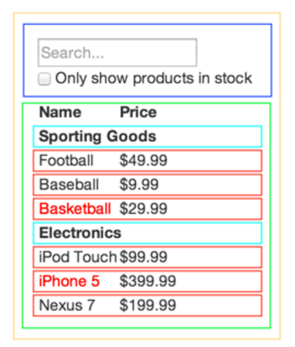
Break The UI Into A Component Hierarchy
Draw boxes around components and name them
Use the single responsibility principle: component only do one thing
UI and data models tend to adhere to the same information architecture
Create components that represent exactly one piece of your data model
Arrange components into a hierarchy
FilterableProductTable (orange): contains the entirety of the example
SearchBar (blue): receives all user input
ProductTable (green): displays and filters the data collection based on user input
ProductCategoryRow (turquoise): displays a heading for each category
ProductRow (red): displays a row for each product
Notes:
https://facebook.github.io/react/docs/thinking-in-react.html
The first thing you'll want to do is to draw boxes around every component (and subcomponent) in the mock and give them all names. If you're working with a designer, they may have already done this, so go talk to them! Their Photoshop layer names may end up being the names of your React components!
But how do you know what should be its own component? Just use the same techniques for deciding if you should create a new function or object. One such technique is the single responsibility principle, that is, a component should ideally only do one thing. If it ends up growing, it should be decomposed into smaller subcomponents.
Since you're often displaying a JSON data model to a user, you'll find that if your model was built correctly, your UI (and therefore your component structure) will map nicely. That's because UI and data models tend to adhere to the same information architecture, which means the work of separating your UI into components is often trivial. Just break it up into components that represent exactly one piece of your data model.
You'll see here that we have five components in our simple app. We've italicized the data each component represents.
FilterableProductTable (orange): contains the entirety of the example
SearchBar (blue): receives all user input
ProductTable (green): displays and filters the data collection based on user input
ProductCategoryRow (turquoise): displays a heading for each category
ProductRow (red): displays a row for each product
If you look at ProductTable, you'll see that the table header (containing the "Name" and "Price" labels) isn't its own component. This is a matter of preference, and there's an argument to be made either way. For this example, we left it as part of ProductTablebecause it is part of rendering the data collection which is ProductTable's responsibility. However, if this header grows to be complex (i.e. if we were to add affordances for sorting), it would certainly make sense to make this its own ProductTableHeader component.
Now that we've identified the components in our mock, let's arrange them into a hierarchy. This is easy. Components that appear within another component in the mock should appear as a child in the hierarchy:
FilterableProductTable
SearchBar
ProductTable
ProductCategoryRow
ProductRow

Slide 6
Build A Static Version in React
Build a version that takes your data model and renders the UI but has no interactivity
Build components that reuse other components and pass data using props, don't use state at all to build this static version
The component at the top of the hierarchy (FilterableProductTable) will take your data model as a prop
class ProductCategoryRow extends React.Component { render() { return <tr><th colSpan="2">{this.props.category}</th></tr>; } } class ProductRow extends React.Component { render() { var name = this.props.product.stocked ? this.props.product.name : <span style={{color: 'red'}}> {this.props.product.name} </span>; return ( <tr> <td>{name}</td> <td>{this.props.product.price}</td> </tr> ); } }
<div id="container"> <!-- This element's contents will be replaced with your component. --> </div>
body { padding: 5px }
Notes:
https://facebook.github.io/react/docs/thinking-in-react.html
Now that you have your component hierarchy, it's time to implement your app. The easiest way is to build a version that takes your data model and renders the UI but has no interactivity. It's best to decouple these processes because building a static version requires a lot of typing and no thinking, and adding interactivity requires a lot of thinking and not a lot of typing. We'll see why.
To build a static version of your app that renders your data model, you'll want to build components that reuse other components and pass data using props. props are a way of passing data from parent to child. If you're familiar with the concept of state, don't use state at all to build this static version. State is reserved only for interactivity, that is, data that changes over time. Since this is a static version of the app, you don't need it.
You can build top-down or bottom-up. That is, you can either start with building the components higher up in the hierarchy (i.e. starting with FilterableProductTable) or with the ones lower in it (ProductRow). In simpler examples, it's usually easier to go top-down, and on larger projects, it's easier to go bottom-up and write tests as you build.
At the end of this step, you'll have a library of reusable components that render your data model. The components will only have render() methods since this is a static version of your app. The component at the top of the hierarchy (FilterableProductTable) will take your data model as a prop. If you make a change to your underlying data model and call ReactDOM.render() again, the UI will be updated. It's easy to see how your UI is updated and where to make changes since there's nothing complicated going on. React's one-way data flow (also called one-way binding) keeps everything modular and fast.
Simply refer to the React docs if you need help executing this step.

Slide 7
Identify The Minimal (but complete) Representation Of UI State
To make your UI interactive, you need to be able to trigger changes to your underlying data model
React makes this easy with state
Determine the minimal set of mutable state that your app needs
Don't Repeat Yourself!
Think of all of the pieces of data in the example application
The original list of products
The search text the user has entered
The value of the checkbox
The filtered list of products
Go through each one and figure out which one is state
Is it passed in from a parent via props? If so, it probably isn't state.
Does it remain unchanged over time? If so, it probably isn't state.
Can you compute it based on any other state or props in your component? If so, it isn't state.
So finally, our state is:
The search text the user has entered
The value of the checkbox
Notes:
https://facebook.github.io/react/docs/thinking-in-react.html
To make your UI interactive, you need to be able to trigger changes to your underlying data model. React makes this easy with state.
To build your app correctly, you first need to think of the minimal set of mutable state that your app needs. The key here is DRY: Don't Repeat Yourself. Figure out the absolute minimal representation of the state your application needs and compute everything else you need on-demand.
For example, if you're building a TODO list, just keep an array of the TODO items around; don't keep a separate state variable for the count. Instead, when you want to render the TODO count, simply take the length of the TODO items array.
Think of all of the pieces of data in our example application. We have:
- The original list of products
- The search text the user has entered
- The value of the checkbox
- The filtered list of products
Let's go through each one and figure out which one is state. Simply ask three questions about each piece of data:
1. Is it passed in from a parent via props? If so, it probably isn't state.
2. Does it remain unchanged over time? If so, it probably isn't state.
3. Can you compute it based on any other state or props in your component? If so, it isn't state.
The original list of products is passed in as props, so that's not state. The search text and the checkbox seem to be state since they change over time and can't be computed from anything. And finally, the filtered list of products isn't state because it can be computed by combining the original list of products with the search text and value of the checkbox.
So finally, our state is:
The search text the user has entered
The value of the checkbox

Slide 8
Identify Where Your State Should Live
Identify which component mutates, or owns, the state
For each piece of state in the app:
Identify every component that renders something based on that state.
Find a common owner component
Either the common owner or another component higher up in the hierarchy should own the state
If you can't find a component where it makes sense to own the state, create a new component simply for holding the state and add it somewhere in the hierarchy above the common owner component
class FilterableProductTable extends React.Component { constructor(props) { super(props); this.state = { filterText: '', inStockOnly: false }; } render() { return ( <div> <SearchBar filterText={this.state.filterText} inStockOnly={this.state.inStockOnly} /> <ProductTable products={this.props.products} filterText={this.state.filterText} inStockOnly={this.state.inStockOnly} /> </div> ); } }
Notes:
https://facebook.github.io/react/docs/thinking-in-react.html
OK, so we've identified what the minimal set of app state is. Next, we need to identify which component mutates, or owns, this state.
Remember: React is all about one-way data flow down the component hierarchy. It may not be immediately clear which component should own what state. This is often the most challenging part for newcomers to understand, so follow these steps to figure it out:
For each piece of state in your application:
Identify every component that renders something based on that state.
Find a common owner component (a single component above all the components that need the state in the hierarchy).
Either the common owner or another component higher up in the hierarchy should own the state.
If you can't find a component where it makes sense to own the state, create a new component simply for holding the state and add it somewhere in the hierarchy above the common owner component.
Let's run through this strategy for our application:
ProductTable needs to filter the product list based on state and SearchBar needs to display the search text and checked state.
The common owner component is FilterableProductTable.
It conceptually makes sense for the filter text and checked value to live in FilterableProductTable
Cool, so we've decided that our state lives in FilterableProductTable. First, add an instance property this.state = {filterText: '', inStockOnly: false} to FilterableProductTable's constructor to reflect the initial state of your application. Then, pass filterText and inStockOnly to ProductTable and SearchBar as a prop. Finally, use these props to filter the rows in ProductTable and set the values of the form fields in SearchBar.
You can start seeing how your application will behave: set filterText to "ball" and refresh your app. You'll see that the data table is updated correctly.

Slide 9
Add Inverse Data Flow
Add support for data flowing the other way
In this example, the form components deep in the hierarchy need to update the state in FilterableProductTable
React makes this data flow explicit to make it easy to understand how your program works, but it does require a little more typing than traditional two-way data binding
Since components should only update their own state, FilterableProductTable will pass a callback to SearchBar that will fire whenever the state should be updated
We can use the onChange event on the inputs to be notified of it. And the callback passed by FilterableProductTable will call setState(), and the app will be updated
class FilterableProductTable extends React.Component { constructor(props) { super(props); this.state = { filterText: '', inStockOnly: false }; } render() { return ( <div> <SearchBar filterText={this.state.filterText} inStockOnly={this.state.inStockOnly} /> <ProductTable products={this.props.products} filterText={this.state.filterText} inStockOnly={this.state.inStockOnly} /> </div> ); } }
Notes:
https://facebook.github.io/react/docs/thinking-in-react.html
So far, we've built an app that renders correctly as a function of props and state flowing down the hierarchy. Now it's time to support data flowing the other way: the form components deep in the hierarchy need to update the state in FilterableProductTable.
React makes this data flow explicit to make it easy to understand how your program works, but it does require a little more typing than traditional two-way data binding.
If you try to type or check the box in the current version of the example, you'll see that React ignores your input. This is intentional, as we've set the value prop of the input to always be equal to the state passed in from FilterableProductTable.
Let's think about what we want to happen. We want to make sure that whenever the user changes the form, we update the state to reflect the user input. Since components should only update their own state, FilterableProductTable will pass a callback to SearchBar that will fire whenever the state should be updated.
We can use the onChange event on the inputs to be notified of it. And the callback passed by FilterableProductTable will call setState(), and the app will be updated.
Though this sounds complex, it's really just a few lines of code. And it's really explicit how your data is flowing throughout the app.

Slide 10
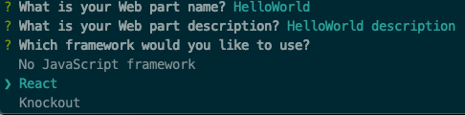
How to create a React web part
Create a new web part by running the Yeoman SharePoint Framework Generator
yo @microsoft/sharepoint
When prompted for a web framework, select React

Slide 11
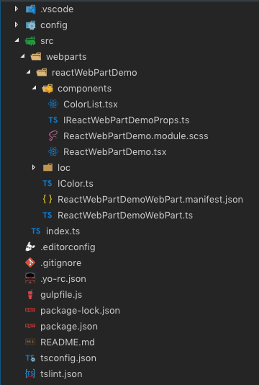
Structure of SPFx React project
SPFx web part same as non-React web part
./src/webparts/[..]/[..]WebPart.ts
Web part’s render() method creates an instance of a React control and adds to the page
React control located in components subfolder in *.tsx file

Slide 12
Demo Creating a SharePoint Framework webpart which uses React
Notes:
Demo steps:
https://github.com/SharePoint/sp-dev-training-spfx-react-fabric/tree/master/Demos/01-webpart

Slide 13

Summary
React 101
How to create a React web part
Structure of the basic template

Slide 14
Using React and Office UI Fabric React Components
Using React and Office UI Fabric React Components

Slide 15
Using React and Office UI Fabric React Components
Office UI Fabric
Fabric React
Adding Fabric React to SPFx Projects

Slide 16
What is the Office UI Fabric?
Built by Microsoft
All about styling instead of JavaScript
Integrates with other frameworks
Language support

Slide 17
Open Source
The Office UI Fabric project is developed and maintained by Microsoft in order to...
Help the development community build Office Add-ins and Office 365 web apps that integrate seamlessly with Office
Provide a point of reference for the evolving Office 365 design language that anyone can reference
Enable the community to contribute to better experiences for everyone who builds for Office

Slide 18
Monitor Releases and Contribute
Microsoft releases changes to the design language, components, and other assets frequently, and will make these updates available to the community.
If features are deprecated MS notes that in the change log, and the feature will be removed from the next major release.
Change Log
https://github.com/OfficeDev/Office-UI-Fabric/releases
Contribute In the GitHub Repository
https://github.com/OfficeDev/Office-UI-Fabric

Slide 19

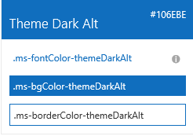

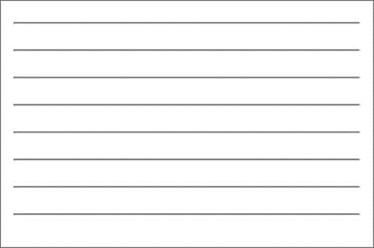

Fabric Core styling
Fonts and typography
Segoe font family + type ramp, official Office 365 iconography
Color
Official Office 365 color palette
Branded assets
Product symbols + product filetype symbols
Animations
Official Office 365 selection of easings and animations
Responsive grid
Tailored to Office 365 silhouettes
Notes:
When I talk about what we make available to developers, there are two broad categories: core and components
Core is the basic, fundamental elements of our design language that devs (MS devs included) can use to integrate apps, web parts, and custom solutions into Office/Office 365 and (of course) SP experiences

Slide 20
Styles
Office UI Fabric provides styles to allow you to implement the following things in your applications:
Typography
Color
Icons
Animations
Responsive Grid
Localization

Slide 21
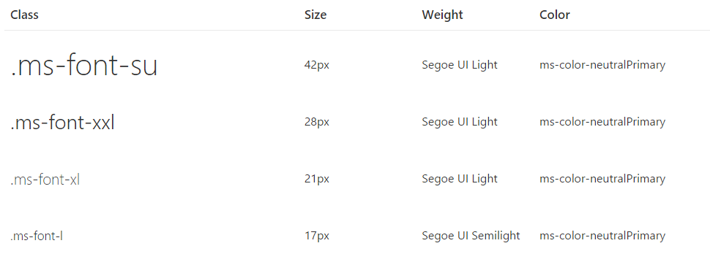
Typography
Base font classes
Fabric includes 10 base font classes that represent the type ramp for the Office Design Language. Each base class sets a default size, weight, and color.

Slide 22
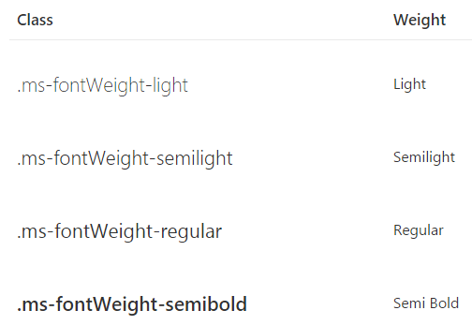
Typography
Helper font classes
Use one of several helper font classes to change the text weight

Slide 23
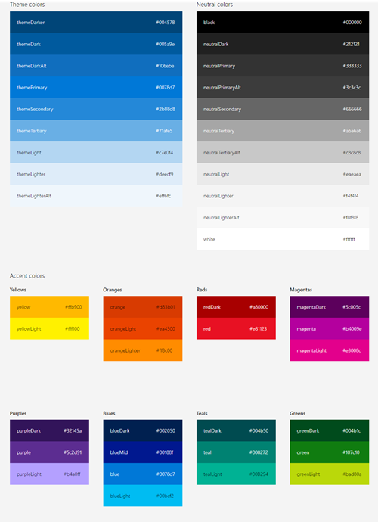
Color
Includes 9 theme colors and 11 neutral colors
Each has helper classes for text, border, background, and hover states
These color classes act as hooks into the Office 365 suite-wide theming system
When the theming system is enabled and your app or Add-in is consuming the suite navigation, these classes pick up the user's chosen theme

Slide 24
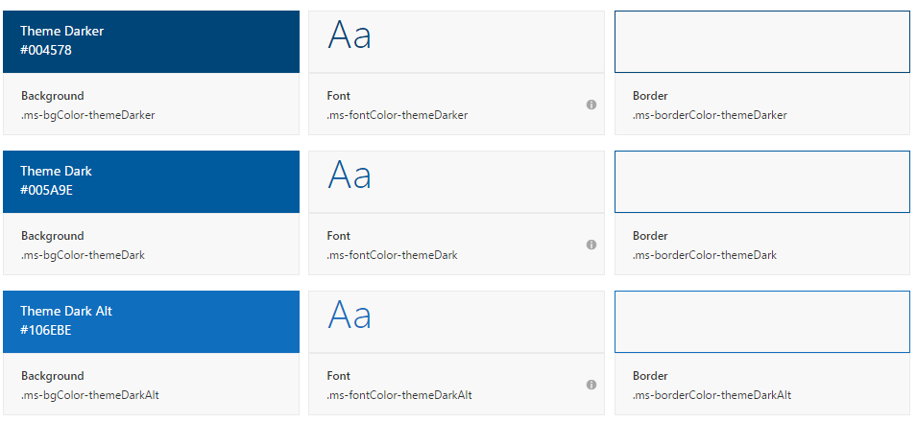
Color
Theme colors
Use theme colors in wayfinding, navigation, and key interactions like primary actions and current or selected indicators

Slide 25
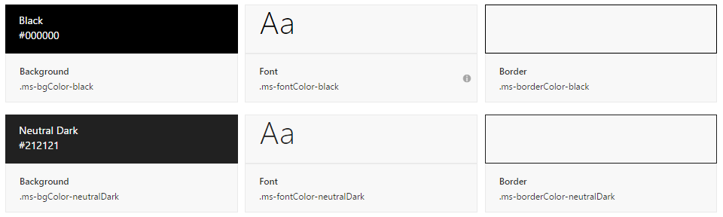
Color
Neutral Colors
Neutral colors include black, gray, and white. Use darker shades of gray for primary content, such as text and titles
Use black sparingly for high-impact strings (labels, names) and hover states
Use lighter shades of gray for supporting graphic elements and page areas

Slide 26
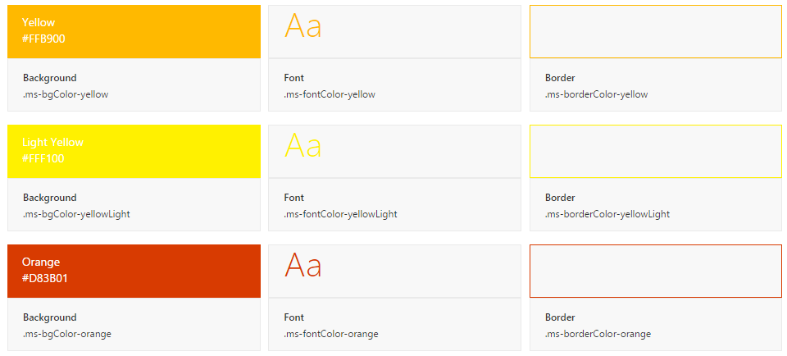
Color
Accent Colors
Fabric also includes accent colors from the Microsoft color palette

Slide 27
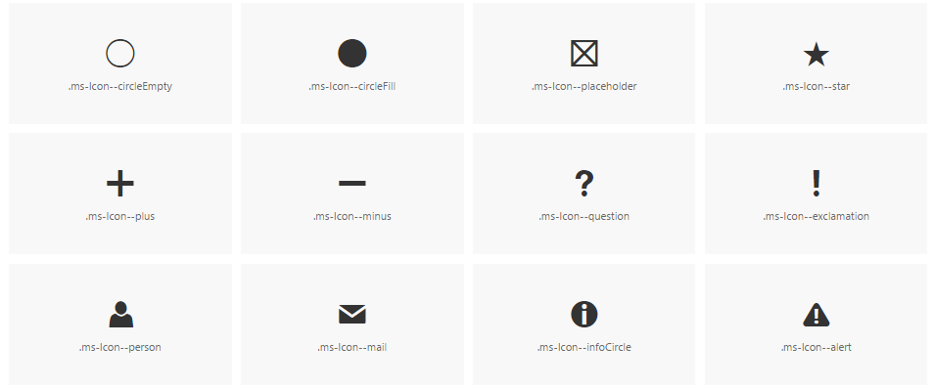
Icons
Fabric uses a custom font for its iconography
Font contains glyphs that you can scale, color, and style in any way
You can even flip them for right-to-left localization

Slide 28
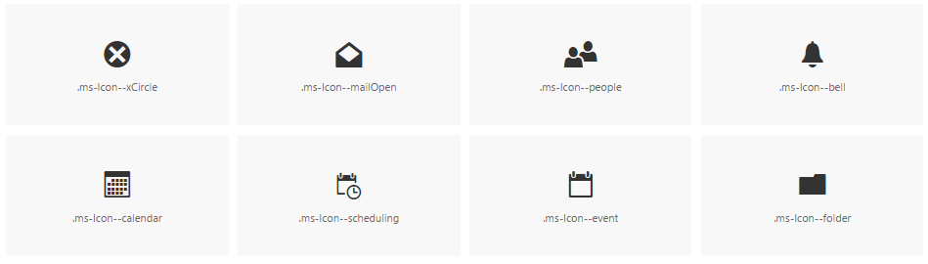
Icons
To use the icons, combine the base ms-Icon class with a modifier class for the specific icon.
<i class="ms-Icon ms-Icon--mail" aria-hidden="true"></i>
Note the aria-hidden attribute, which prevents screen readers from reading the icon. In cases where meaning is conveyed only through the icon, such as an icon-only navigation bar, be sure to apply an aria-label to the button for accessibility.

Slide 29

Side panel animations
When choosing a motion for side panels, consider the origin of the triggering element
Use the motion to create a link between the action and the resulting UI
For example, if the triggering element is on the right side of the interface, consider having the panel move in from the right

Slide 30

Dialog animations
When choosing a motion for dialogs, consider the origin and tone of the content
For a warning or error dialog, a quick fade in might be appropriate
If the dialog appears when a user chooses an item to get more information, a scale-up might be appropriate

Slide 31
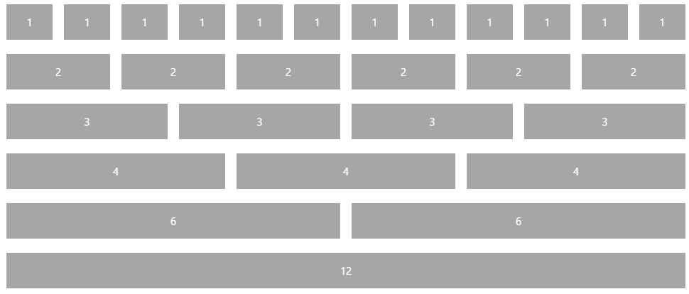
Responsive Grid
Fabric comes with a mobile-first, 12-column, responsive grid that you can use to create flexible layouts for a variety of screen sizes and device types

Slide 32
Localization
Right-to-left support
Fabric comes with an alternate CSS file for pages written in right-to-left (RTL) languages, such as Arabic and Hebrew
This reverses the order of columns in the responsive grid, making it easy to create an RTL layout without writing additional templates
Future versions of Fabric will also reverse some icons and provide additional helper utilities

Slide 33
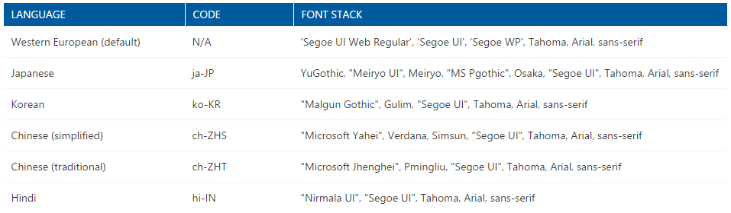
Localization
Language-optimized fonts
By default, Fabric presents all text using the Western European character set of Segoe UI
For languages with other characters, Fabric will either serve a version of Segoe UI with a different character set or use a system font
Fabric supports many language codes, which utilize different font stacks

Slide 34

Fabric React: Office UI Fabric Components
Fabric's components make up the building blocks of your UI and are meant to be consumed as CSS applied to your markup
All JavaScript is presentational to explain behavior
Download the components from the GitHub repository
https://github.com/OfficeDev/Office-UI-Fabric

Slide 35
The Code
Office UI Fabric
https://developer.microsoft.com/fabric
Get Started
https://developer.microsoft.com/fabric#/get-started
OpenSource GitHub Repository
https://github.com/OfficeDev/office-ui-fabric-react

Slide 36
Using Fabric React Controls
Don’t import the entire Fabric React library; only import the control:
import { List } from 'office-ui-fabric-react/lib/List’;
Leverage the control within your React control:
public render(): React.ReactElement<IColorListProps> {
return (
<div>
<List items={ this.props.colors }
onRenderCell={ this._onRenderListCell } />
</div>
);
}

Slide 37
Demo Leveraging Fabric React in SPFx Projects
Notes:
Demo steps:
https://github.com/SharePoint/sp-dev-training-spfx-react-fabric/tree/master/Demos/02-fabricreact

Slide 38
Summary
Office UI Fabric
Fabric React
Adding Fabric React to SPFx Projects

Slide 39
Using React and Office UI Fabric React Components
Extend existing web part to be dynamic

Slide 40
Extend existing web part to be dynamic
Component properties
Component state
Notify component consumers of changes via events

Slide 41
React Components Are Dynamic
Properties
Public settings on components
Similar to HTML element attributes
Use to provide values into component
Use to publish events to consumers
Defined on the component via TypeScript interfaces
State
State object of a component is a special property bag
React detects when the state changes & triggers a (re)render of the component
Change the state using the component’s setState() method
Defined on the component via TypeScript interfaces

Slide 42
Component Properties
export interface IColorListProps {
colors: IColor[];
}
export class ColorList extends React.Component<IColorListProps, {}> {
public render(): React.ReactElement<IColorListProps> {
return (
<ul>
{
this.props.colors.map(colorItem => (
<li>{ colorItem.title }</li>
))
}
</ul>
);
}
}
<ColorList colors={this._colors} />

Slide 43
Component Properties to Publish Events
export type RemoveColorCallback = (color: IColor) => void;
export interface IColorListProps {
colors: IColor[]; onRemoveColor: RemoveColorCallback;
}
export class ColorList extends React.Component<IColorListProps, {}> {
public render(): React.ReactElement<IColorListProps> {
return ({
this.props.colors.map(colorItem => (
<button value={colorItem.title} onClick={() => this._onButtonClick(color)} />
))
});
}
}
private _onButtonClick(color:IColor): void {
this.props.onRemoveColor(color);
}
<ColorList colors={this._colors} onRemoveColor={ this._removeColor } />

Slide 44
Component State
export interface IReactWebPartDemoState {
colors: IColor[];
}
export default class ReactWebPartDemo extends React.Component<IReactWebPartDemoProps, IReactWebPartDemoState> {
constructor(props: IReactWebPartDemoProps) {
super(props);
this.state = { colors: [] };
}
public render(): React.ReactElement<IReactWebPartDemoProps> {
return (
<ColorList colors={ this.state.colors } onRemoveColor={ this._removeColor } />
);
}
private _removeColor = (colorToRemove: IColor): void => {
const newColors = this.state.colors.filter(color => color != colorToRemove);
this.setState({ colors: newColors });
}
}

Slide 45
Demo Leveraging Fabric React in SPFx Projects
Notes:
Demo steps:
https://github.com/SharePoint/sp-dev-training-spfx-react-fabric/tree/master/Demos/03-dynamic-webpart

Slide 46
Summary
Component properties
Component state
Notify component consumers of changes via events

Slide 47
Reading further
SharePoint Framework
https://docs.microsoft.com/en-us/sharepoint/dev/spfx/sharepoint-framework-overview
Office UI Fabric
https://developer.microsoft.com/fabric
Deploy your client-side web part to a SharePoint page
https://docs.microsoft.com/sharepoint/dev/spfx/web-parts/get-started/serve-your-web-part-in-a-sharepoint-page

Slide 48
Lab In this lab you work with React and the the SharePoint Framework (SPFx) to extend the user interface with the React web framework. aka.ms/spdevwsM4L7
Notes:
Lab manual at:
https://aka.ms/spdevwsm4l7

